Slide 1
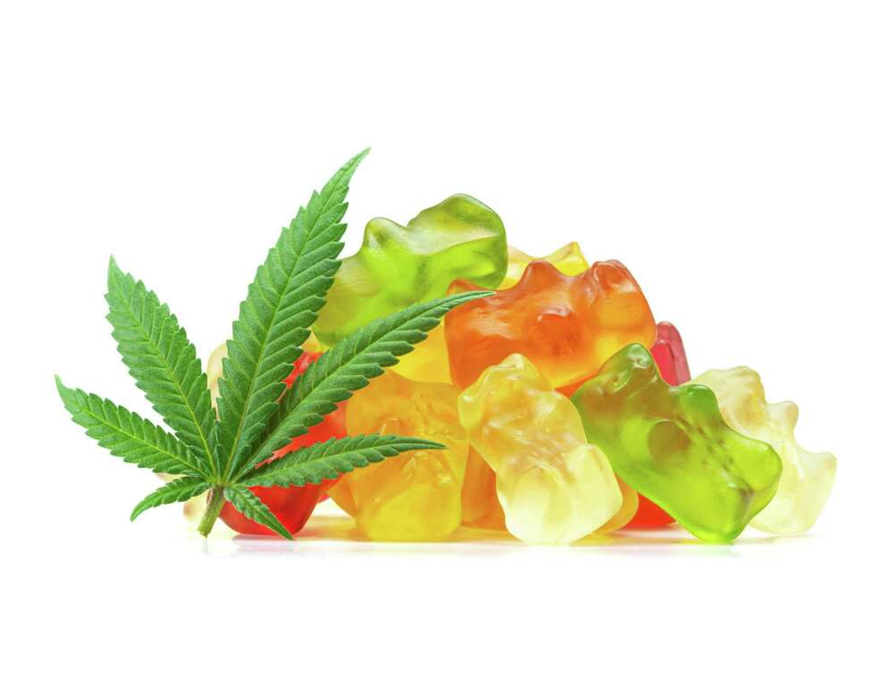
Creating a Culture of Safety: Harm Reduction Strategies for Consumption of Edibles Amongst Youth
Christopher Gaw, MD
2023 MIPA Virtual Conference
November 30th, 2023

Slide 2
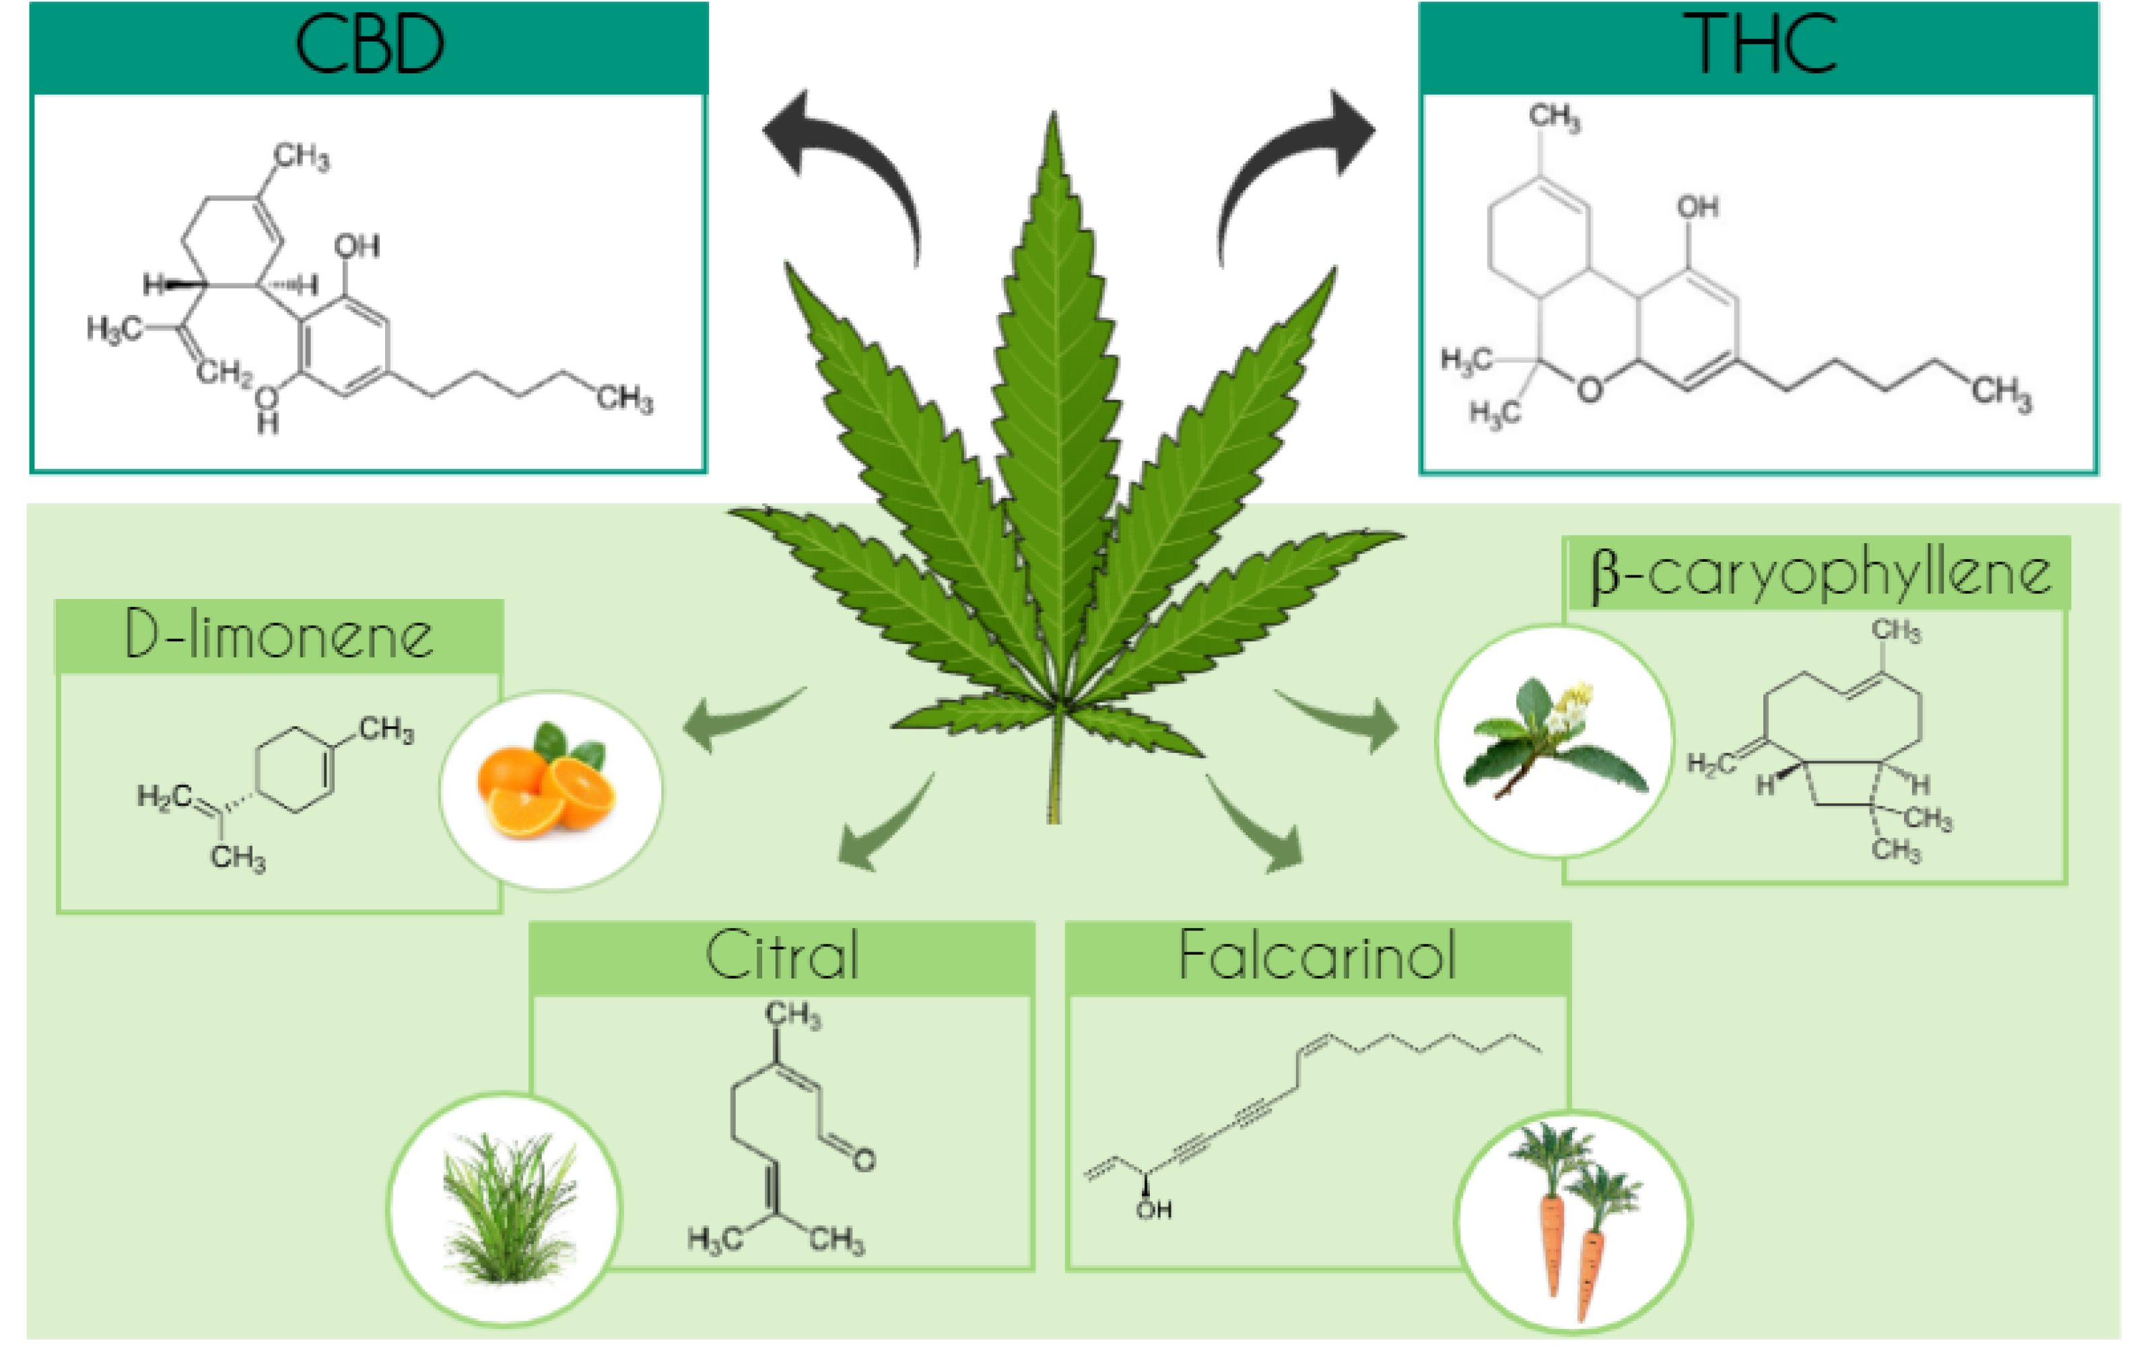
Definitions: Cannabis, THC, Edibles
Notes:
Cannabis sativa, cannabis indica, cannabis ruderalis
>400 compounds technically
Sativa most common because it has highest THC to CBD ratio, indica next most common
THC (delta 9 and 8) is the psychoactive component, CBD typically is not psychoactive and has other anxiolytic, neuroprotective and anxiolytic effects (binds to CB1 and CB2 receptors)
When talking about this topic, we are focusing often on products containing THC
Edibles can be manufactured under regulation, illegally, or “home made” –typically THC edibles are the issue

Slide 3
The Cannabis Product and Policy Landscape

Slide 4
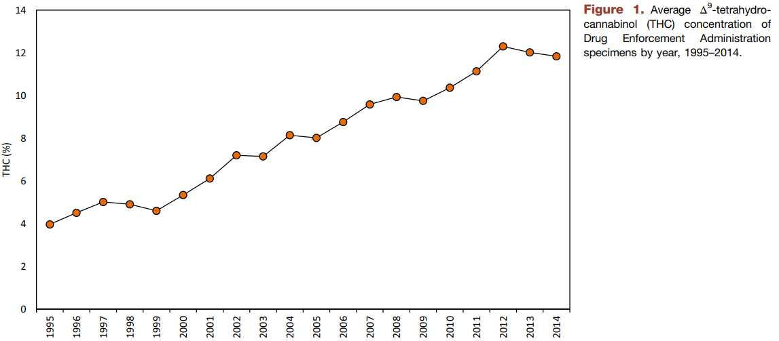
Increasing THC potency increases risk
El Sohly et al. Biol Psychiatry. 2016.
Notes:
Data from materials confiscated by DEA, they ran specimens through validated gas chromatography
Potency has increased from 4% in 1995 to 12% in 2014. THC ratio to CBD has shifted from 14:1 to 80:1 over that same time period
Though these are not regulated products, it’s a proxy for potency
We know that current (legal/regulated) products can have THC potencies of up to 30-40% (e.g., oils)

Slide 5
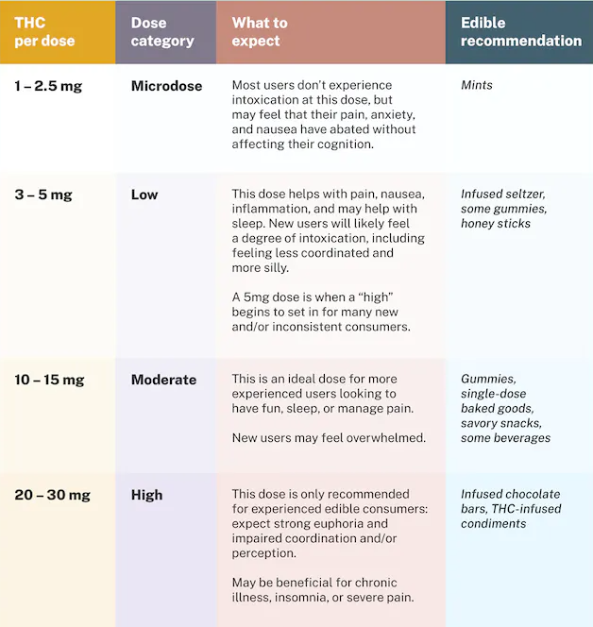
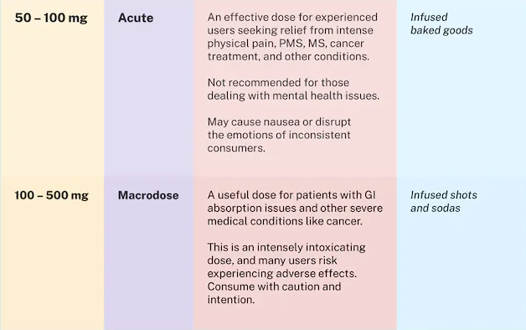
Potent Edible Products
https://www.leafly.com/learn/consume/edibles/edible-dosing
Notes:
- How does this chart correspond to what is available on the market

Slide 6
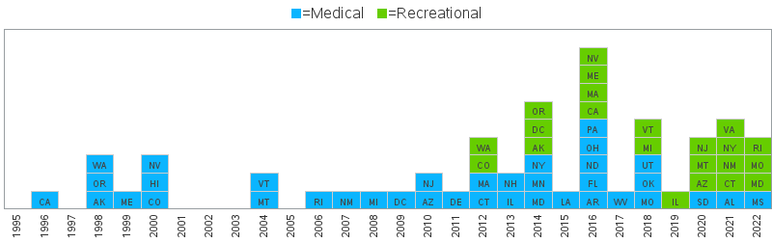
Policy changes are increasing availability
Notes:
CA the first state to legalize medical marijuana
WA and CO the first states to legalize recreational (or adult use) marijuana

Slide 7
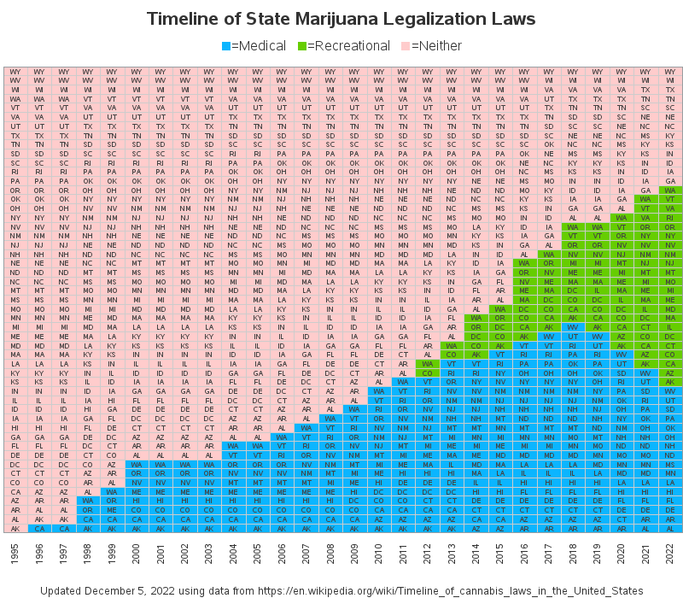
Policy changes are increasing availability
Notes:
- Note these are virtually all ballot initiatives (voter initiated)

Slide 8
Cannabis Consumption and Older Youth
Notes:
How has this impacted children?

Slide 9
State data provided us an early warning
Wang et al. Inj Prev. 2020.
Notes:
- Colorado regional poison center exposure trend data by age
- Saw increases mostly after legalization in 2010 that affected all age groups but most prominent in younger children
- This looked at all cannabis exposures, not just edibles

Slide 10
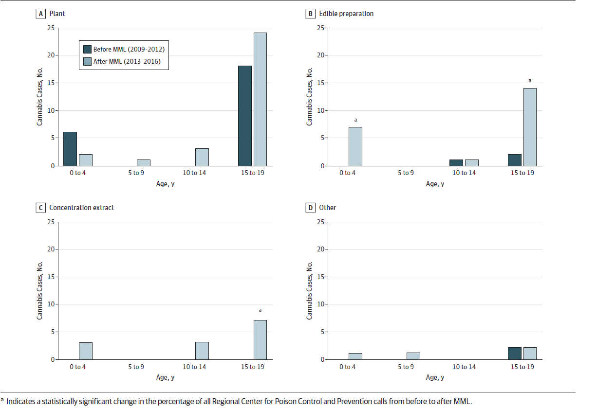
State data provided us an early warning
Whitehill et al. JAMA Netw Open. 2019.
Notes:
- MA PC exposure calls 4 years before and 4 years after legalization of medical marijuana
- Looked at different age groups from 0-19 years
- Note the rise in edibles that appeared basically after passage of legislation

Slide 11
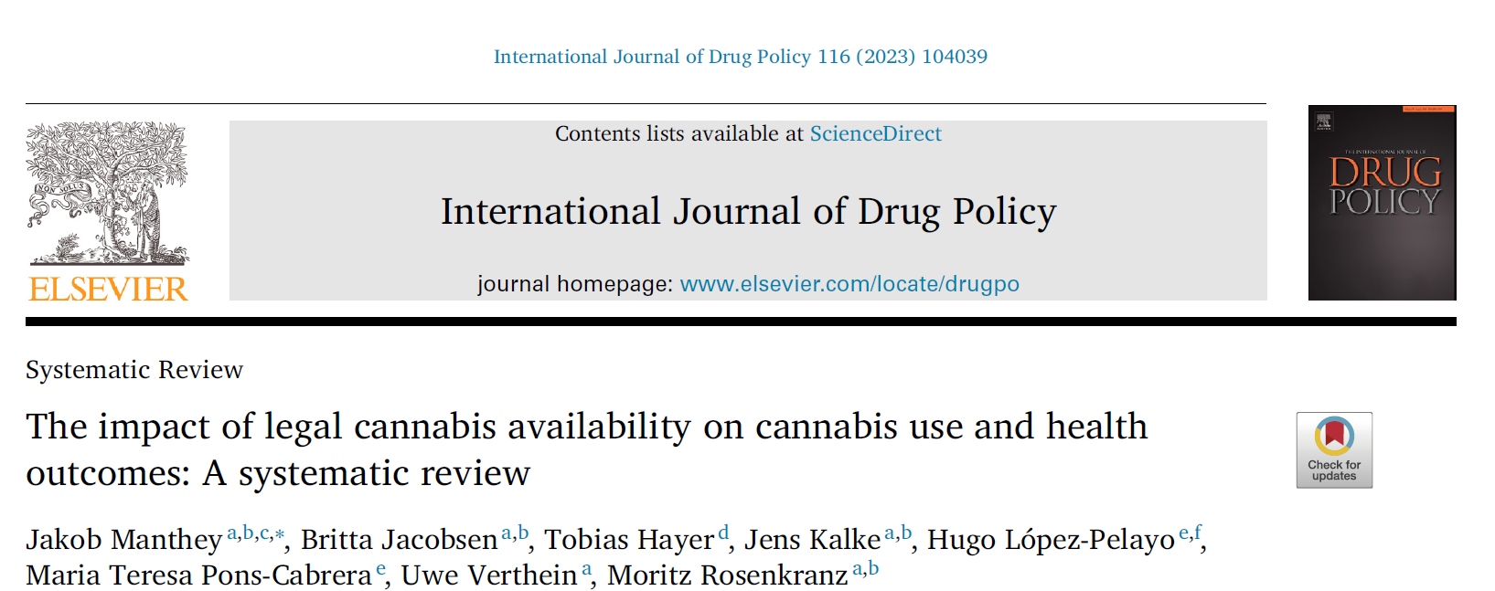
Manthey et al. Int J Drug Policy. 2023.
Notes:
- Screened 6253 studies and looked at 13 studies in North America/US (cannabis with related health indicators)
- Described a positive correlation between cannabis legality and cannabis use, most pronounced in populations that did not have access to cannabis before (i.e., youth/adolescents)
- Correlations to other outcomes like cannabinoid hyperemesis, acute psychosis
- There are other studies detailing shifting acceptability of cannabis use among youth and adults
- This is reflected in these ballot initiatives passing cannabis laws

Slide 12
Cannabis Consumption and Young Children
Notes:
How has this impacted children?
What can happen to children
And how big of a problem has it become
Focus is children <6 years of age

Slide 13
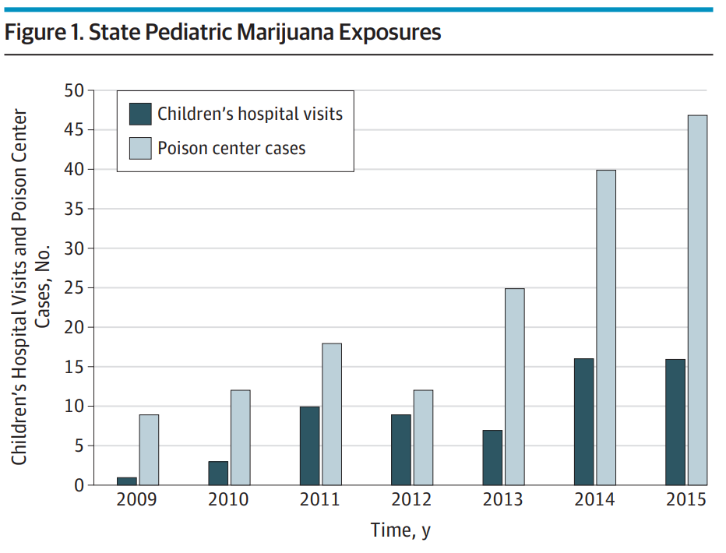
Again, state data provided an early warning
Wang et al. JAMA Peds. 2016.
Notes:
Colorado did pre-/post- legalization study published in JAMA Peds
Described unintentional marijuana exposures in children ages 0-9 (hospital admissions and Poison Control Center cases)
48% of cases involved edible cannabis products

Slide 14
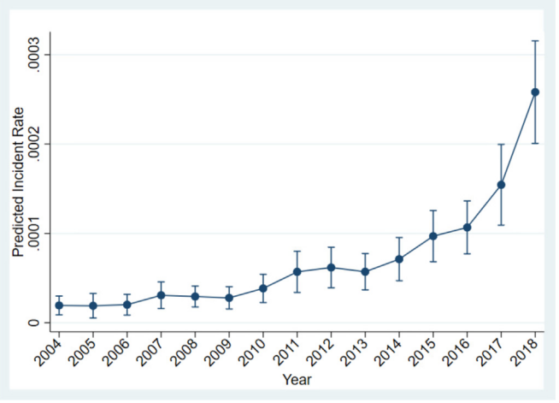
Not just ED visits, but hospitalizations
Bennett et al. Acad Ped. 2022.
Notes:
PHIS data from 2004 to 2018 that included 27 states and D.C.
Found that there was a 13-fold increase in marijuana-related exposures among children <6 y
50% were inpatient, 15% required ICU, 4% required mechanical ventilation
Note, did not explicitly look at edibles

Slide 15
Not just ED visits, but hospitalizations
Bennett et al. Acad Ped. 2022.
Notes:
PHIS data from 2004 to 2018 that included 27 states and D.C.
Found that there was a 13-fold increase in marijuana-related exposures among children <6 y
50% were inpatient, 15% required ICU, 4% required mechanical ventilation
Note did not explicitly look at edibles

Slide 16
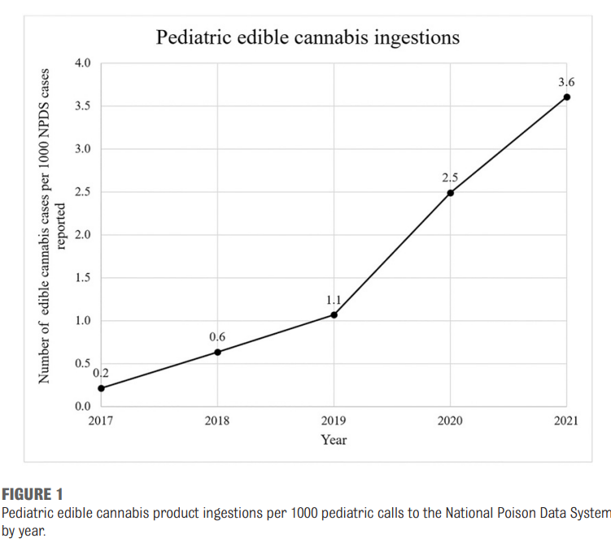
Exposures are increasing nationally
Tweet et al. Pediatrics. 2023.
Notes:
Study used NPDS from 2017 to 2021 looking at specifically edible cannabis product exposures in children <6 years of age
Increase in number exposures of 1375% over the study period
22.7% of exposure calls were admitted to hospitals

Slide 17
Risk
Accessibility
Legality
Acceptability
Potency

Slide 18
Thank you!
Christopher Gaw, MD Christopher.Gaw@NationwideChildrens.org

