Slide 1
Workplace Violence Trends in Illinois
Brett Shannon
12/09/2021
Notes:
Broad overview Workplace Violence Trends
Discuss use of different databases to extract a more complete picture on this topic
Some of the changes we have seen during COVID-19

Slide 2
Introduction
Background
PhD Candidate (UIC)
Medical Physician - AFOEM Advanced Registrar (RACP) – Australia
Expert Advisory Group - Australian National Injury Prevention Strategy 2020-2030
Community Health for past 10 years - Past Chairperson of the Brisbane Aboriginal and Torres Strait Islander Community Health Service

Slide 3
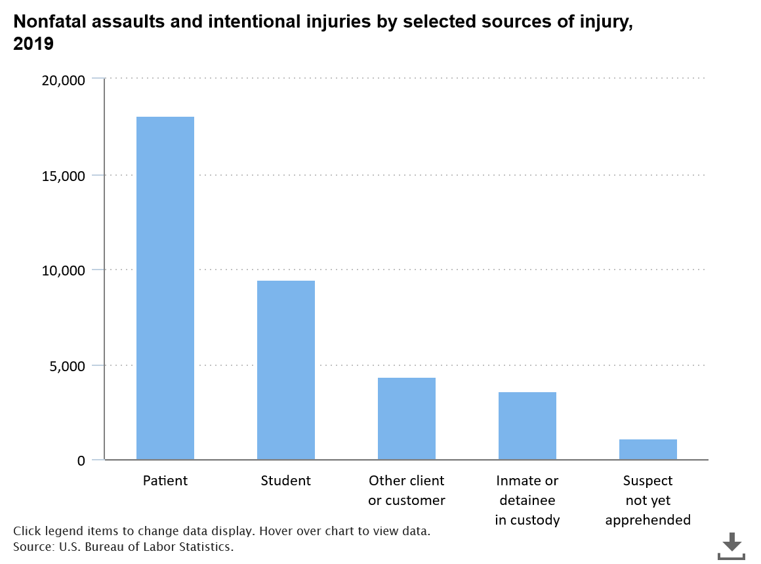
Workplace Violence
2 million American workers are victims of workplace violence each year
Healthcare and social service workers accounted for 73 percent of all nonfatal workplace injuries and illnesses due to violence in 2018
COVID-19 changes - policies around social distancing, PPE requirements and training, remote work
Stress in the workplace – job intensity, belligerent customers, uncertainty about exposure
Aim - Review available data to describe the impact of workplace violence and understand which factors increase violence victimization in Illinois
https://www.bls.gov/iif/oshwc/cfoi/workplace-violence-healthcare-2018.htm

Slide 4
Hospital Workers Compensation Assault-related cases
Hospital data - January 1, 2016 - June 30, 2021
retrospective analysis of all Workers compensation Assault-related injuries among patients in Illinois who sought care at a hospital. The dataset capture both outpatient and inpatient cases.
Data is derived from billing records and represent a census of outpatient and inpatient cases treated in Illinois hospitals from January 2016-June 2021.
Workplace Violence Trends - Methods
FROI
January 1, 2018 - October 30, 2021
FROIs are filed by employers (IL Form 45: Employer’s First Report of Injury)
Reporting requirement: 3 days of lost work time
Who submits? usually the insurance company, or a TPA does batch uploads for various employers
What is done with FROIs? stored/filed; no action from State
Notes:
So we wanted to gather information on Workplace Violence in Illinois to present today.
We used two data sets
The intentional use of physical force or power, threatened or actual, against oneself, another person, or against a group or community, that either results in or has a high likelihood of resulting in injury, death, psychological harm, maldevelopment or deprivation

Slide 5
Hospital Presentations 2016-2021

Slide 6
Monthly Hospital Presentations – All Assaults v Workers Compensation Assaults

Slide 7
Assault cases by Gender
Gender | All Assault cases | Workers Compensation cases
Female | 126380 (46.7) | 3296 (45.1)
Male | 144056 (53.3) | 4014(54.9)
Total | 270436 | 7310
Notes:
Firearm related cases were predominantly male
Sexual assault cases were predominantly female

Slide 8
Workers Compensation Cases – by Age group (2016-June2021) *projected 2021 Final

Slide 9
Workers Compensation Cases – Race/ethnicity (2016-June2021)
 | 2016 | 2017 | 2018 | 2019 | 2020 | 2021 | Total
American Indian or Alaskan Native | 0 | 0 | 3 | 6 | 1 | 1 | 11
Asian | 28 | 45 | 45 | 45 | 30 | 16 | 209
African American | 221 | 272 | 285 | 333 | 245 | 106 | 1462
White Non-Hispanic | 694 | 851 | 812 | 901 | 710 | 387 | 4355
Hispanic | 120 | 154 | 143 | 151 | 136 | 79 | 783
Native Hawaiian or Pacific Islander | 1 | 3 | 0 | 4 | 2 | 0 | 10
Other Race | 75 | 60 | 77 | 78 | 72 | 39 | 401
Unspecified | 19 | 14 | 16 | 15 | 10 | 8 | 82
Total | 1158 | 1399 | 1381 | 1533 | 1206 | 636 | 7313

Slide 10
Workers Comp Assault Category Top 10
Assault Category | Total (n=7313)
Bodily Force | 6057 (82.83%)
Assault Sport Equipment | 477 (6.52%)
Assault Unspecified Means | 353 (4.83%)
Blunt Object | 232 (3.17%)
Sharp Object | 107 (1.46%)
Unspecified Firearm | 61 (0.83%)
Sexual Assault | 19 (0.26%)
Abuse by Non Family Member | 11 (0.15%)
Hit by Motor Vehicle | 10 (0.14%)
Handgun | 8 (0.11%)
Notes:
Workplace viol distr indus, occ, demographics
Public interface
Res HCA, law
Not isolated

Slide 11
Workers Compensation Cases – Nature of Severe Injuries
Nature of Injury | Total (%) (n=7313)
Fracture | 541 (7.40%)
Dislocation | 31 (0.42%)
Internal | 374 (5.11%)
Open Wound | 1268 (17.34%)
Burns | 6 (0.08%)
Blood vessels | 8 (0.11%)
Crush | 7 (0.10%)
Notes:
Check data + %

Slide 12
Workers Compensation Cases – Descriptors
Fractures predominantly of the Face (40.4%) and upper extremities (26.8%)
Open Wounds – 57.9% to the upper extremities, 32.4% to the head and face
95.2% of internal injuries were to the brain
118/7313 (1.6%) Inpatient Cases (>24 hrs at initial hospital)
57/7313 (0.78%) required operation at initial hospital
Mean hospital charges $4455.98 (SD=$14160.62)
Minimal variation by Month or Weekday

Slide 13
First Reports of Injury (FROI) cases 2018-2021
Notes:
Reason use multiple data systems…
FROI made by supervisor and insurance company
Fall off in numbers
Distribution by injury and occupation does not match data from national surveys that are comprehensive
But dataset captures detailed information about a case including work demographics, narrative, what happened to them, how much work missed, what is being paid out,

Slide 14
FROI Assault data January 2018 – October 2021
1103 cases
39% (427/1103) occurred off site on other premises
84% Full time, 10% part time
60% > $20 average per hour (n=688)
12 Deaths
USDA coding
Urban (1-3) = 91.8%
Rural (4-9) = 8.2%
Notes:
Probable assault cases in FROI system but labelled as contusion etc
How protect workers off premises polciies – health care etc sending people pairs, identifying high risk customers, clients and patients
Refusal of service, if feel unsafe
Patient would be disqualified from home care services
Slide prior – methods, data sources
How protect workers off premises polciies – health care etc sending people pairs, identifying high risk customers, clients and patients
Refusal of service, if feel unsafe
Patient would be disqualified from home care services

Slide 15
FROI - Cause of Injury
 | Frequency | % (n=1103)
Person in Act of a Crime | 858 | 77.79
Fellow Worker, Patient or Other Person | 116 | 10.52
Struck or Injured, NOC | 23 | 2.09
Gunshot | 21 | 1.90
Strain or Injury By, NOC | 14 | 1.27
Animal or Insect | 8 | 0.73

Slide 16
FROI – Nature of Injury
Nature of Injury | Frequency | % (n=1103)
Contusion | 206 | 18.68
Strain or Tear | 195 | 17.68
All Other non specific Injuries | 116 | 10.52
Fracture | 109 | 9.88
Mental Stress | 93 | 8.43
Sprain or Tear | 86 | 7.80
Laceration | 50 | 4.53
Multiple Physical Injuries Only | 50 | 4.53
Concussion | 38 | 3.45
Puncture | 38 | 3.45
Inflammation | 32 | 2.90

Slide 17
Assault by Occupation (2018-2021)
Occupation | Frequency | % (total=1103)
Protective Services | 297 | 26.93
Uncoded insufficient information | 139 | 12.60
Healthcare Practitioners and Technical | 108 | 9.79
Transportation and Material Moving | 100 | 9.07
Office and Administrative Support | 79 | 7.16
Sales and Related | 78 | 7.07
Education, Training, and Library | 44 | 3.99
Management | 44 | 3.99
Community and Social Service | 41 | 3.72
Food Preparation and Serving Related | 40 | 3.63
Notes:
This is the problem with FROI
Requires reporting by supervisor or insurance company
And we know a substantial number of cases are incorrectly reported
Problem when use this for surveillance data – the reason why don’t rely on single data system no system complete
FROI mis characterize nature of injury and cause
Probable assault cases in FROI system but labelled as contusion etc

Slide 18
Mental Stress claims (n=93)
20% uncoded industry / occupation
INDUSTRY
Transport and warehousing (16%), Retail and Trade, Accommodation (15%) and Food Services (11%) Finance and Insurance (11%)
OCCUPATION
Sales and related ( 17.2%), Office and Admin support (17.2% ), Transport (11.8), Installation, maintenance and repair (9.7%)

Slide 19
CDC Recommendations during COVID
Minimize contact
Workplace safe zones
Training opportunities
Avoid work in isolation
Workplace policies and notices
Security Systems
https://www.cdc.gov/coronavirus/2019-ncov/community/organizations/business-employers/limit-workplace-violence.html
Notes:
https://www.cdc.gov/coronavirus/2019-ncov/community/organizations/business-employers/limit-workplace-violence.html
Adopt a formal workplace violence prevention training
Training can prove to be a huge asset. It helps employees comprehend the entire process and gives them the information and skills they need to carry out their obligations under the program.
When it comes to workplace violence training, the focus is frequently on the ways to manage a violent situation. But it is just as vital to teaching employees how to communicate effectively and empathically. It has the ability to prevent violence before it even begins.
Creating a Workplace Violence Policy
An essential part of your approach to avoid workplace violence should be a written policy in place. A policy that expresses your stance on fighting and other violent behavior in simple but clear terms.
For fighting and workplace violence, you may either write a distinct policy or leverage many existing rules you may already have. It is possible that you have a harassment policy as well. Make sure that your harassment policy includes and prohibits fighting.

Slide 20
The Joint Commission; Workplace Violence Prevention standards for Hospitals
Implementing new and revised workplace violence prevention requirements that will take effect January 1, 2022.
Defining workplace violence, including dissemination of a formal definition
Establishing leadership oversight
Conducting worksite analysis
Developing policies and procedures for the prevention of workplace violence
Setting standards for reporting systems, data collection, and analysis
Creating post incident strategies
Training and educating staff to decrease workplace violence
https://www.jointcommission.org/standards/r3-report/r3-report-issue-30-workplace-violence-prevention-standards/
Notes:
In facility nurses and aids
Home health care workers have very little protection
At least hospitals there is police protection, colleagues that can jump in, training
In the field workers are alone, some of the fatal occupational injuries are in the community setting
Everyone – social work, health care workers, insurance people have to visit others houses

Slide 21
Work from Home – the secondary job site
Employers must, by law, provide a safe working environment for their staff and should ensure there is no risk involved with working from home.
Repetitive strain injuries
Slips, trips, Falls
Workers Compensation Nominal Insurer v Hill [2020] NSWCA54

Slide 22
Summary/Recap
Different types of data required for different purposes;
Describe magnitude and impact of violence
Understanding which factors increase risk for violent victimization
Knowing how effective violence prevention programs are
Racial disparities in Workers' compensation violence
Protection of workers off premises requires further research and discussion
Long term mental health and emotional impact of occupational violence has not commanded the attention of many researchers and should be a central research topic in the future.
Notes:
Intersection between data sets
With violence
are hospital, security, transport best reporting systems or true
How protect workers off premises polciies – health care etc sending people pairs, identifying high risk customers, clients and patients
Refusal of service, if feel unsafe
Patient would be disqualified from home care services
Slide prior – methods, data sources
How protect workers off premises polciies – health care etc sending people pairs, identifying high risk customers, clients and patients
Refusal of service, if feel unsafe
Patient would be disqualified from home care services
The human cost in grief and pain, of course, cannot be calculated. In fact, much of it is almost invisible
As with its impacts, some causes of violence are easy to see. Others are deeply rooted in the social, cultural and economic fabric of human life. Recent research suggests that while biological and other individual factors explain some of the predisposi- tion to aggression, more often these factors interact with family, community, cultural and other external factors to create a situation where violence is likely to occur.
—describing the magnitude and impact of violence; —understanding which factors increase the risk for violent victimization and perpetration; —knowing how effective violence prevention programmes are.

