Slide 1
A Regional Analysis of Youth Suicide in the Midwest, 2016-2019
National Violent Death Reporting System (NVDRS) Committee

Slide 2
Illinois
Population - 12.8 million
Began in 2015
Began data collection in 2005 but not part of NVDRS, shadow system funded by Illinois Dept. of Public Health and The Joyce Foundation
Number of Youth Suicides 2016-2019: 223
16 participating counties, 82% captured

Slide 3
Indiana
Population – 6.63 million
Began in 2015
Number of Youth Suicides, 2016-2019: 197
92 counties, 100% captured

Slide 4
Michigan
Population – 9.93 million (2016)
Began in 2010
Number of Youth Suicides, 2016-2019:
83 counties, 100% captured

Slide 5
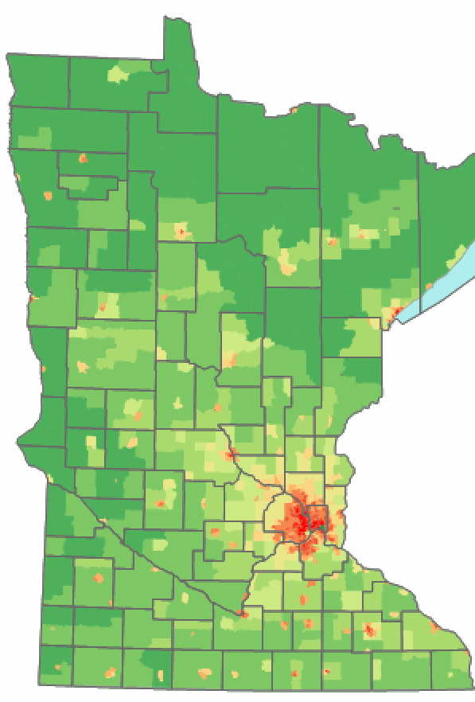
Minnesota
Population – 5.64 million
Began in 2015
Number of Youth Suicides, 2016-2019: 176
87 Counties, 11 Tribes, 100% captured

Slide 6
Ohio
Population – 11.6 million
Began in 2010
Number of Youth Suicides, 2016-2019: 352
88 counties, 100% captured

Slide 7
Wisconsin
Population – 5.82 million
Began in 2004
Number of Youth Suicides, 2016-2019:150
72 counties, 100% captured

Slide 8
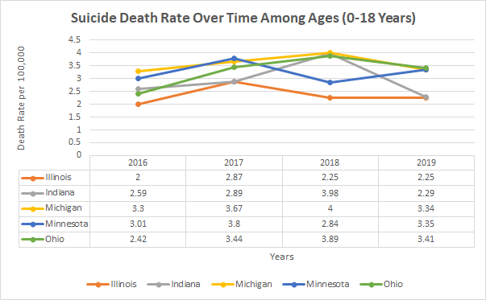
Youth Suicide Rate Over Time

Slide 9
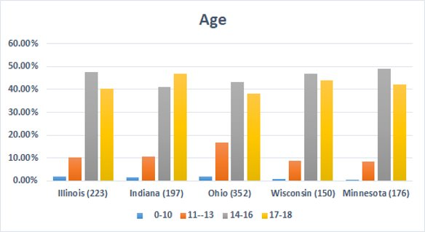
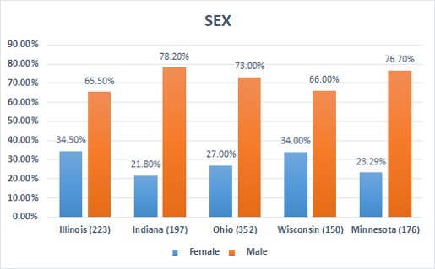
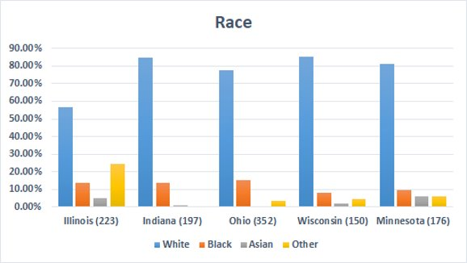
Demographics

Slide 10
Weapon Type
Illinois
Indiana
Minnesota
Ohio
Ohio
Wisconsin
Wisconsin

Slide 11
Toxicology

Slide 12
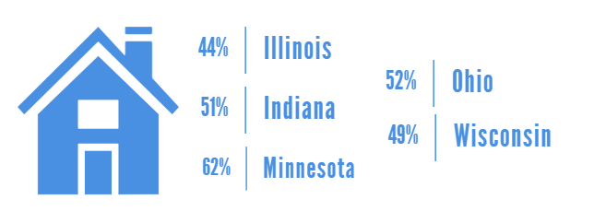
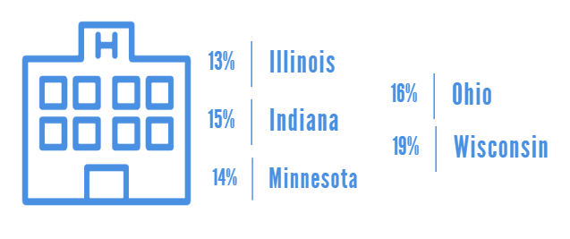
Place of Death

Slide 13
Mental Health
Illinois
Minnesota
Indiana
Depression
Bipolar Disorder
Anxiety
Depression
Anxiety
ADHD
28%
6.9%
3.8%
28.9%
13.6%
5.1%

Slide 14
Mental Health
Wisconsin
Ohio
Depression
ADHD
Anxiety
Depression
Anxiety
ADD
35%
12%
12%
43.3%
22%
8.7%

Slide 15
Relationship and Life Stressors
Various circumstances related to a fatal incident
Checkbox for “yes” but could be unknown
Yes=clear evidence in LE or CME documentation
Questions to consider:
What about this surprises you?
What is as you’d expect?
How can we explain the results?
What can we do for prevention?

Slide 16
Most Common Relationship and Life Stressors
All other circumstances has zero (0) cases checked: Family stressor; Victim known to authorities; Prior CPS report on child’s house

Slide 17
Top 5 by State
Illinois
Int. partner problem
Family relationship problem
Indiana
Int. partner problem
Family relationship problem
Minnesota
Family relationship problem
Argument
Wisconsin
Ohio
Argument
Argument
Family relationship problem
Int. partner problem
Argument
Int. partner problem
Argument
Family relationship problem
Other relationship problem
Hist. abuse and neglect
Hist. abuse and neglect
Other relationship problem
Hist. abuse and neglect
Other relationship problem
Hist. abuse and neglect
Other relationship problem
Int. partner problem
Other relationship problem
Hist. abuse and neglect

Slide 18
Suicide-Specific Circumstances

Slide 19
Top 3 by State
Illinois
Left a note
Indiana
History of expressed suicidal thoughts
Minnesota
Left a note
Wisconsin
Ohio
Left a note
History of expressed suicidal thoughts
History of expressed suicidal thoughts
History of suicide attempt
History of suicide attempts
Contributing criminal legal problem
History of expressed suicidal thoughts
History of suicide attempts
History of expressed suicidal thoughts
History of suicide attempts
Left a note
History of suicide attempts

Slide 20
Disclosed intent to…

Slide 21
Common Themes
14–16-year-old white males are at an increased risk for suicide.
All states saw approximately 50% of deaths involving hanging, strangulation, or suffocation.
Amphetamines were the leading toxicological substance found at the time of death followed by marijuana.
Approximately 50% of deaths were in a home.
A diagnosed mental health problem was the leading cause of death.
Stressors: intimate partners and family
Intent disclosure: friends, but uncommon
Consistency across states for stressors and circumstances

Slide 22
Prevention
Youth suicide in the Midwest is neither increasing nor decreasing.
Intimate partners and family should understand the possible effect they can have
Friends (and others) need to destigmatize talking about suicide. Take it seriously.
What resources do schools have?
How can parents learn to “suicide proof” their home?

Slide 23
Panel Discussion
Thank You!

